Slide 1
INSIGHTVISTA COMPETITION
E-commerce Transaction Sales Analysis
SUBJECT
PEN (Enrollment) No | Name
240840116014 | Vidhika Chaudhari
240840116021 | Poorva Deore
250843116007 | Aditi Goswami
250843116020 | Ritixa Surati
Data Analytics and Visualization
SUBJECT CODE
1IT508
COMPETITION
INSIGHTVISTA
Notes:
Replace each [Add name] with the student name matching the enrollment number in that row.

Slide 2
Raw dataset: observations
8
Dec 2010 - Dec 2011
Columns in raw data
Period covered
Field | Meaning
InvoiceNo | Invoice id (C prefix = cancelled)
StockCode | Product code
Description | Product name
Quantity | Units on the line
InvoiceDate | Date and time of invoice
UnitPrice | Price per unit
CustomerID | Customer id
Country | Customer country
Data issues observed
Missing CustomerID and Description
Cancelled invoices and negative quantities
Zero or negative UnitPrice
Duplicate rows
Non-product lines such as POSTAGE
Notes:
Replace [raw rows] with the row count before cleaning. Confirm each issue in the right-hand list against your own raw file and add counts (for example: X rows with missing CustomerID).

Slide 3
Raw to final: steps and reasons
Step | What we did | Why
1. Load and inspect | Imported the raw file into Power Query and checked columns and types | Understand the structure and spot problems first
2. Remove duplicates | Dropped exact duplicate rows | Duplicates inflate sales and quantity
3. Handle missing values | Treated blank CustomerID and Description | Needed for correct customer and product analysis
4. Remove invalid rows | Removed cancelled invoices (C prefix), negative quantity and zero or negative price | Returns and bad prices distort revenue
5. Fix data types | InvoiceDate to date/time, numbers to numeric, IDs to text | Enables date hierarchy, sums and correct grouping
6. Create sales_amount | sales_amount = Quantity x UnitPrice | One revenue measure used by every chart
Notes:
Edit the steps to match exactly what you did in Power Query, and add before and after row counts for steps 2 to 4.

Slide 4
Solution: final clean dataset and work done
9.73M
5M
24,446
4,373
Total sales
Units sold
Distinct orders
Customers
Final clean dataset
What we have done
9 columns: 8 original plus sales_amount
Valid sales lines only, one row per product per invoice
No duplicates, cancellations or invalid prices
Date hierarchy ready: year, quarter, month, day
Cleaned and transformed the data in Power Query
Built a Power BI dashboard: 2 slicers, 4 KPI cards, 4 charts
Analysed trend, products, countries and volume
Turned findings into recommendations
Notes:
Add the final row count after cleaning if you have it. KPI values are from the dashboard cards.

Slide 5
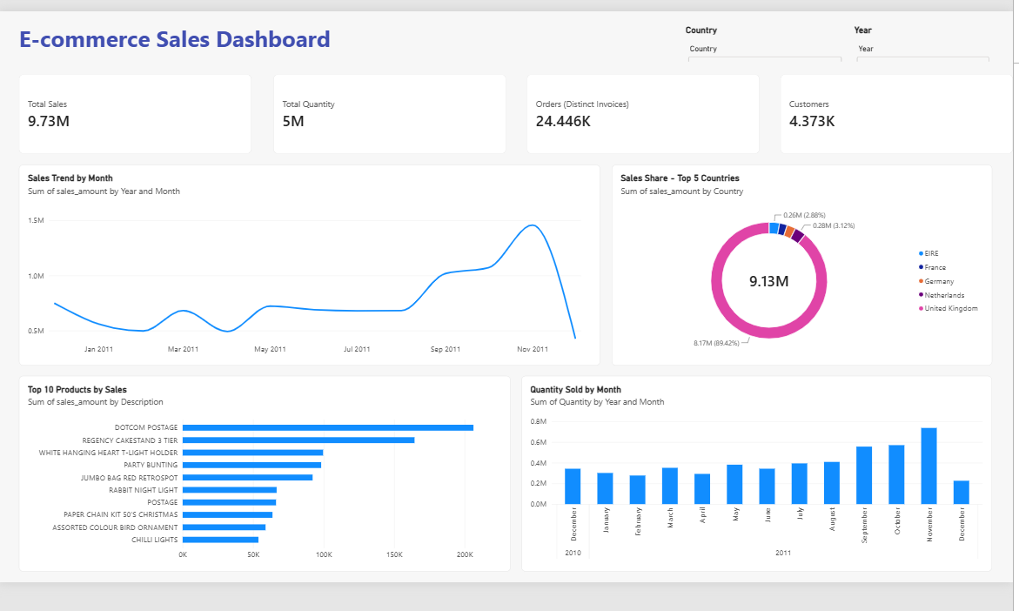
Visual: Power BI dashboard
KPI cards
Sales, quantity, orders, customers
Sales trend
Monthly sales, Dec 2010 to Dec 2011
Country share
Top 5 countries by sales
Top 10 products
Ranked by sales amount
Quantity by month
Monthly units sold
Slicers
Filter by country and year
Notes:
Show the live dashboard if possible and demonstrate a slicer.

Slide 6
Observations and insights
Sales
Seasonality
Products
9.73M from 24,446 orders; average order value is about 398.
Sales climb from September and peak in November 2011 (about 1.5M). The December dip is likely a partial month.
DOTCOM POSTAGE (about 200K) and Regency Cakestand 3 Tier (about 165K) lead. Postage rows are charges, not products.
Markets
Customers
Recommendations
UK is about 89% of top-5 sales (8.17M of 9.13M). EIRE, France, Germany and Netherlands are about 3% or less each.
4,373 customers placing about 5.6 orders each, with about 2,225 spend per customer.
Stock and promote early for Sep to Nov, keep best sellers available, grow beyond the UK and reward repeat buyers.
Notes:
Say pattern, reason, action for each card. Mention the partial December month and that POSTAGE rows are shipping charges before a judge asks.

